Slide 1

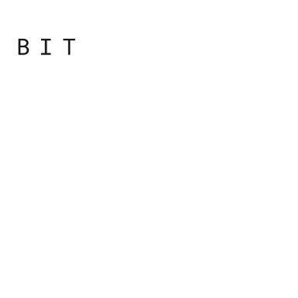
Programming
Principles
with JavaScript

Slide 2

Day overview
Recap and Coding Conventions
Switch
Introduction to Arrays
Loops

Slide 3
Introduction to Arrays

Slide 4
Arrays
It's simply a list (a sequence) of values
Instead of using one variable to store one value, you can use one array variable to store any number of values as elements of the array

Slide 5
Arrays
Each value is called an element, and each element has a numeric position in the array, known as its index
JavaScript arrays are untyped: an array element may be of any type, and different elements of the same array may be of different types

Slide 6
Arrays
To declare a variable that contains an empty array
> var a = [];
To define an array that has three elements
> var a = [1, 2, 3];
// 3 elements of various types
> var misc = [1.1, true, "a"];

Slide 7
Arrays
Array elements may even be objects or other arrays, which allows you to create complex data structures, such as arrays of objects and arrays of arrays

Slide 8
Accessing an Array Element
var a = [1, 2, 3];
The elements contained in an array are indexed with consecutive numbers starting from zero.
The first element has index (or position) 0, the second has index 1, and so on.
Index | Value
0 | 1
1 | 2
2 | 3

Slide 9
Accessing an Array Element
var a = [1, 2, 3];
Specify the index of an element inside square brackets
So, a[0] gives you the first element of the array a, a[1] gives you the second, and so on
Index | Value
0 | 1
1 | 2
2 | 3

Slide 10
Array Length
Number of elements in the array can be obtained with length property of the array.
var a = [];
a.length // 0
var b = [1, 2, 3];
b.length // 3

Slide 11
Adding/Updating Array Elements
Using the index, you can also update the values of the elements of an array
> var a = [1, 2, 3];
> a[2] = 'three';
> a
[1, 2, "three"]
Notes:
ToDo c?

Slide 12
Adding/Updating Array Elements
Add more elements by addressing an index that didn't exist before
> a[3] = 'four';
> a
[1, 2, "three", "four"]

Slide 13
Adding/Updating Array Elements
If you add a new element, but leave a gap in the array, those elements in between don't exist and return the undefined value if accessed
> var a = [1, 2, 3];
> a[6] = 'smth';
> a
> [1, 2, "three", undefined x 3, "smth"]

Slide 14
Deleting Elements
> var a = [1, 2, 3];
> delete a[1];
true
> a;
[1, undefined, 3]
> typeof a[1];
"undefined"
To delete an element, you use the delete operator
After the deletion, the length of the array does not change

Slide 15
Arrays of Arrays
Arrays can contain all types of values, including other arrays
> var a = [1, "two", false, null, undefined];
> a;
[1, "two", false, null, undefined]
> a[5] = [1, 2, 3];
[1, 2, 3]
> a;
[1, "two", false, null, undefined, Array[3]]

Slide 16
Arrays of arrays
Arrays can contain all types of values, including other arrays
To access an element in a nested array, you refer to the element index in another set of square brackets
> var a = [[1, 2, 3], [4, 5, 6]];
> a;
[Array[3], Array[3]]
> a[1][1];
5;

Slide 17
String Array Notation
> var s = 'element';
> s[0];
"e"
> s[1];
"l"
> s[3];
"m"
You can use the array notation to access individual characters inside a string
String is behaving like an array of characters

Slide 18
Summary
An array is a data store
An array contains indexed elements
Indexes start from zero and increment by one
To access an element of an array, you use its index in square brackets
An array can contain any type of data, including other arrays

Slide 19

Practical
Notes:
Starting with the bootcamp
Hoping to catch the wave and achieve much more

